Slide 1


Md. Majharul Islam-1811678642
TanjEla Islam- 182 2553 042 Group - 05

Slide 2
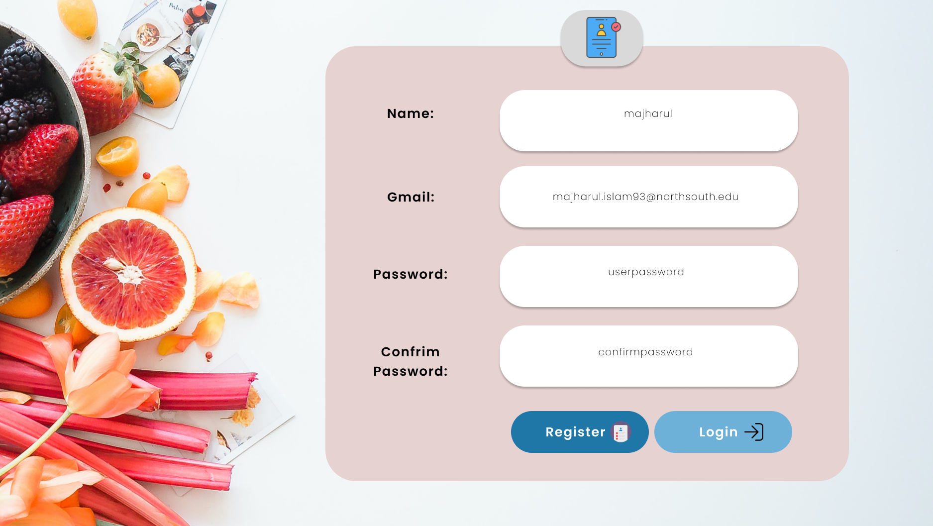
Registration

Slide 3
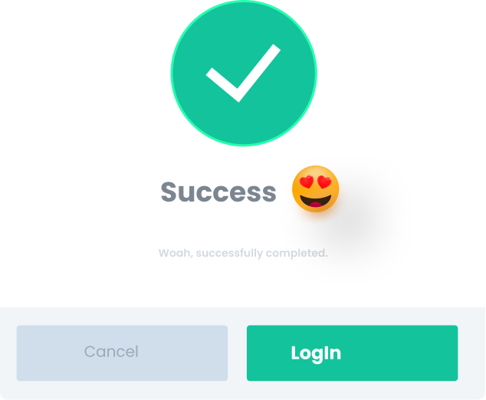

Slide 4
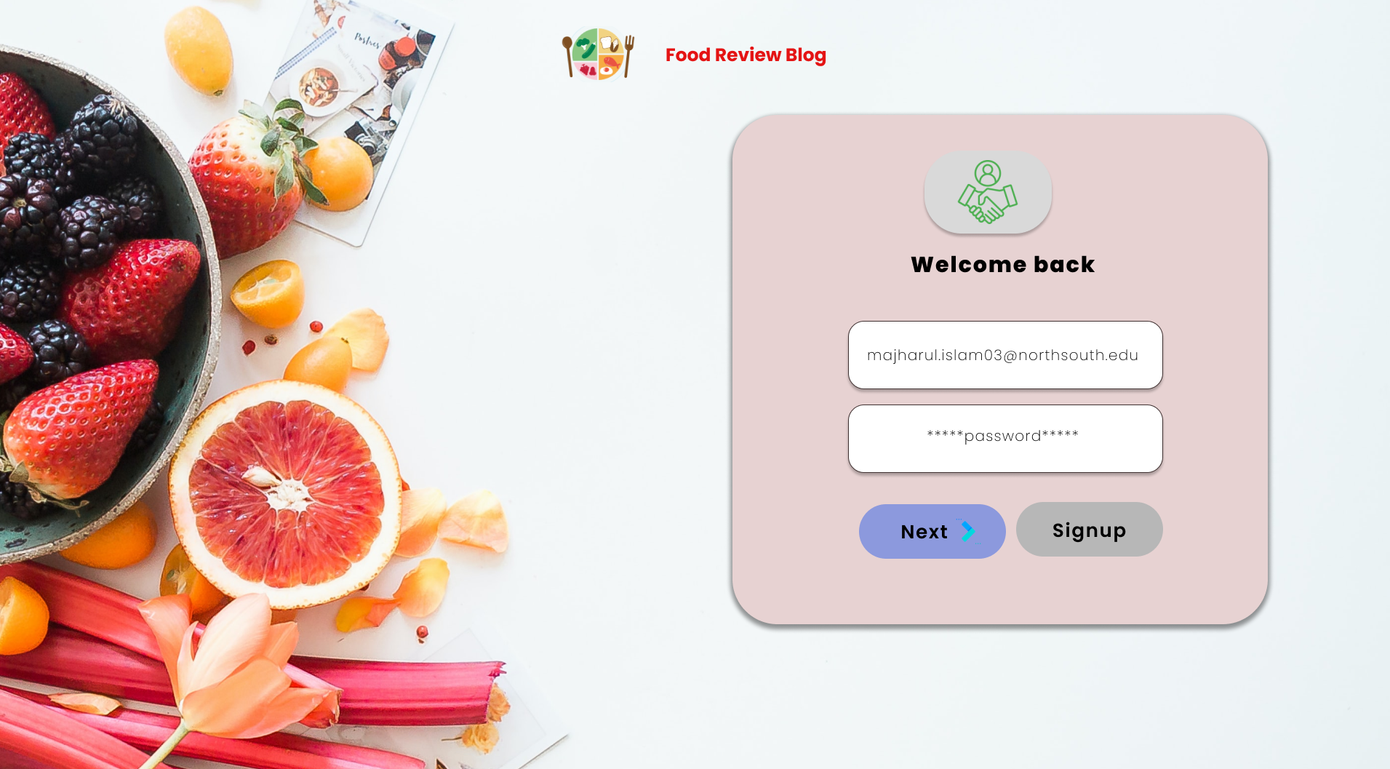
Login Part

Slide 5
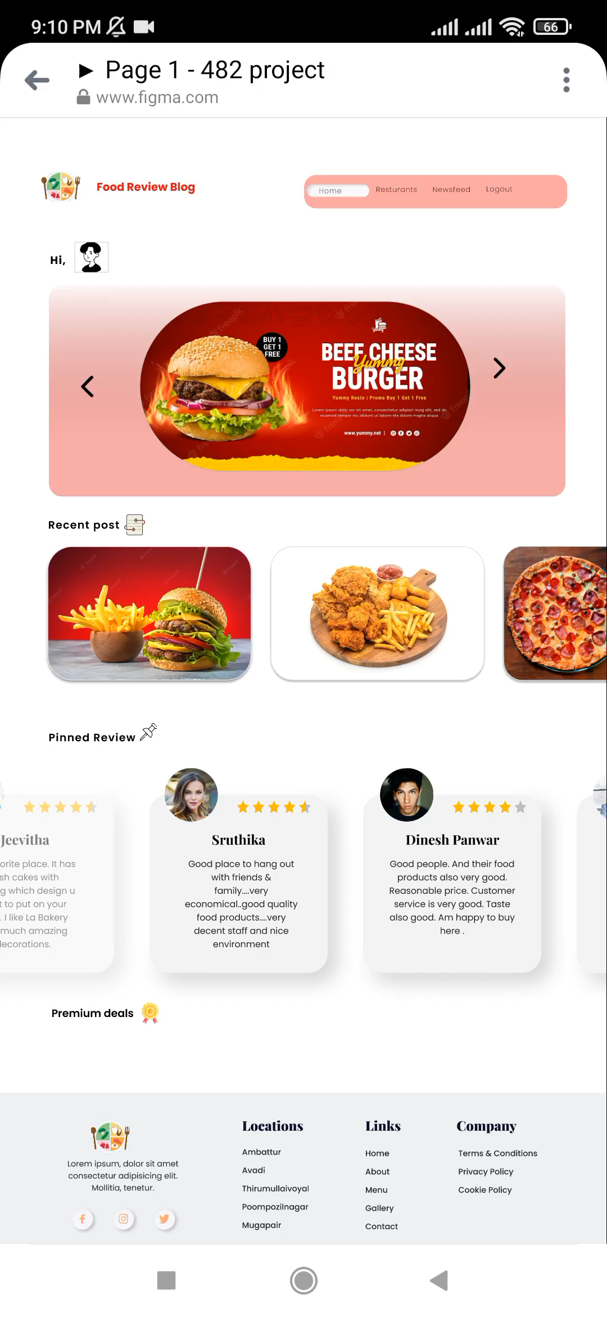
homepage
On top of the Home Page contains Different Restaurant’s Special Offer or Notice
Recent Posts will contain only those posts user have created
Admin will Control Pin Posts

Slide 6
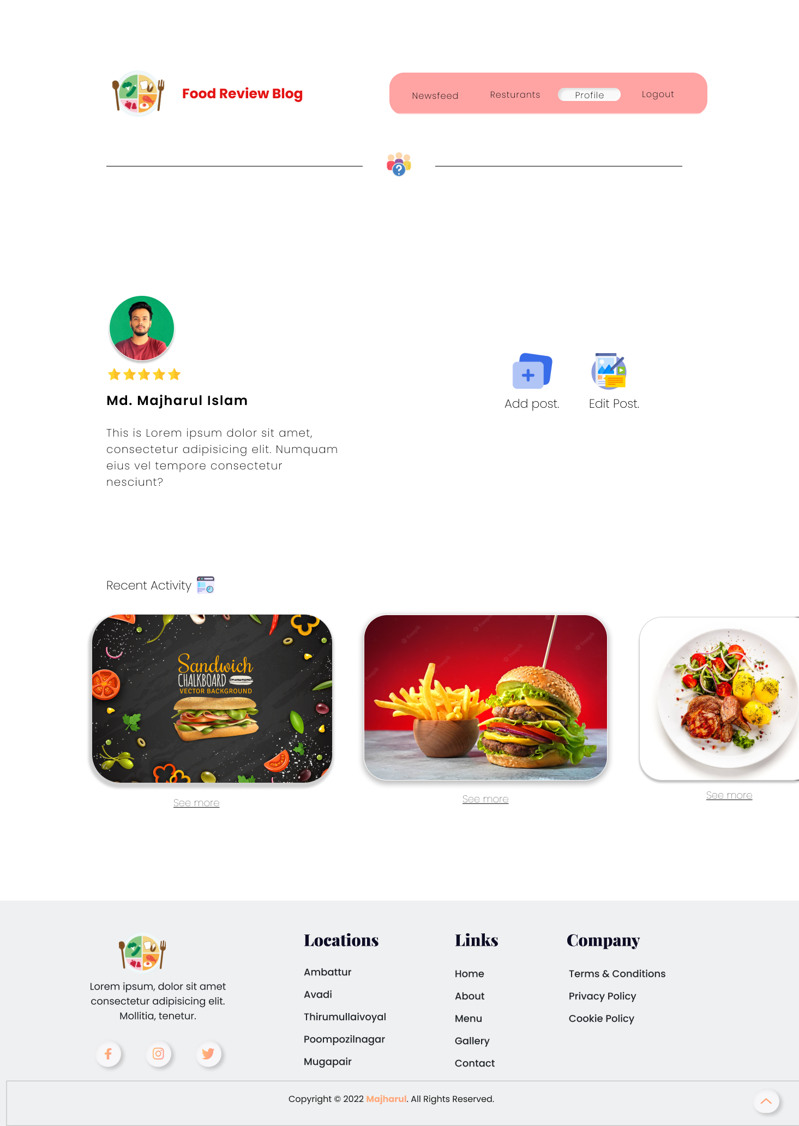

User profile
A registered User Manage, Update His Profile
Share his Opinion by Creating Post
Even Can Edit previous Post
Recent Activity – Uses Activity of a Registered User

Slide 7
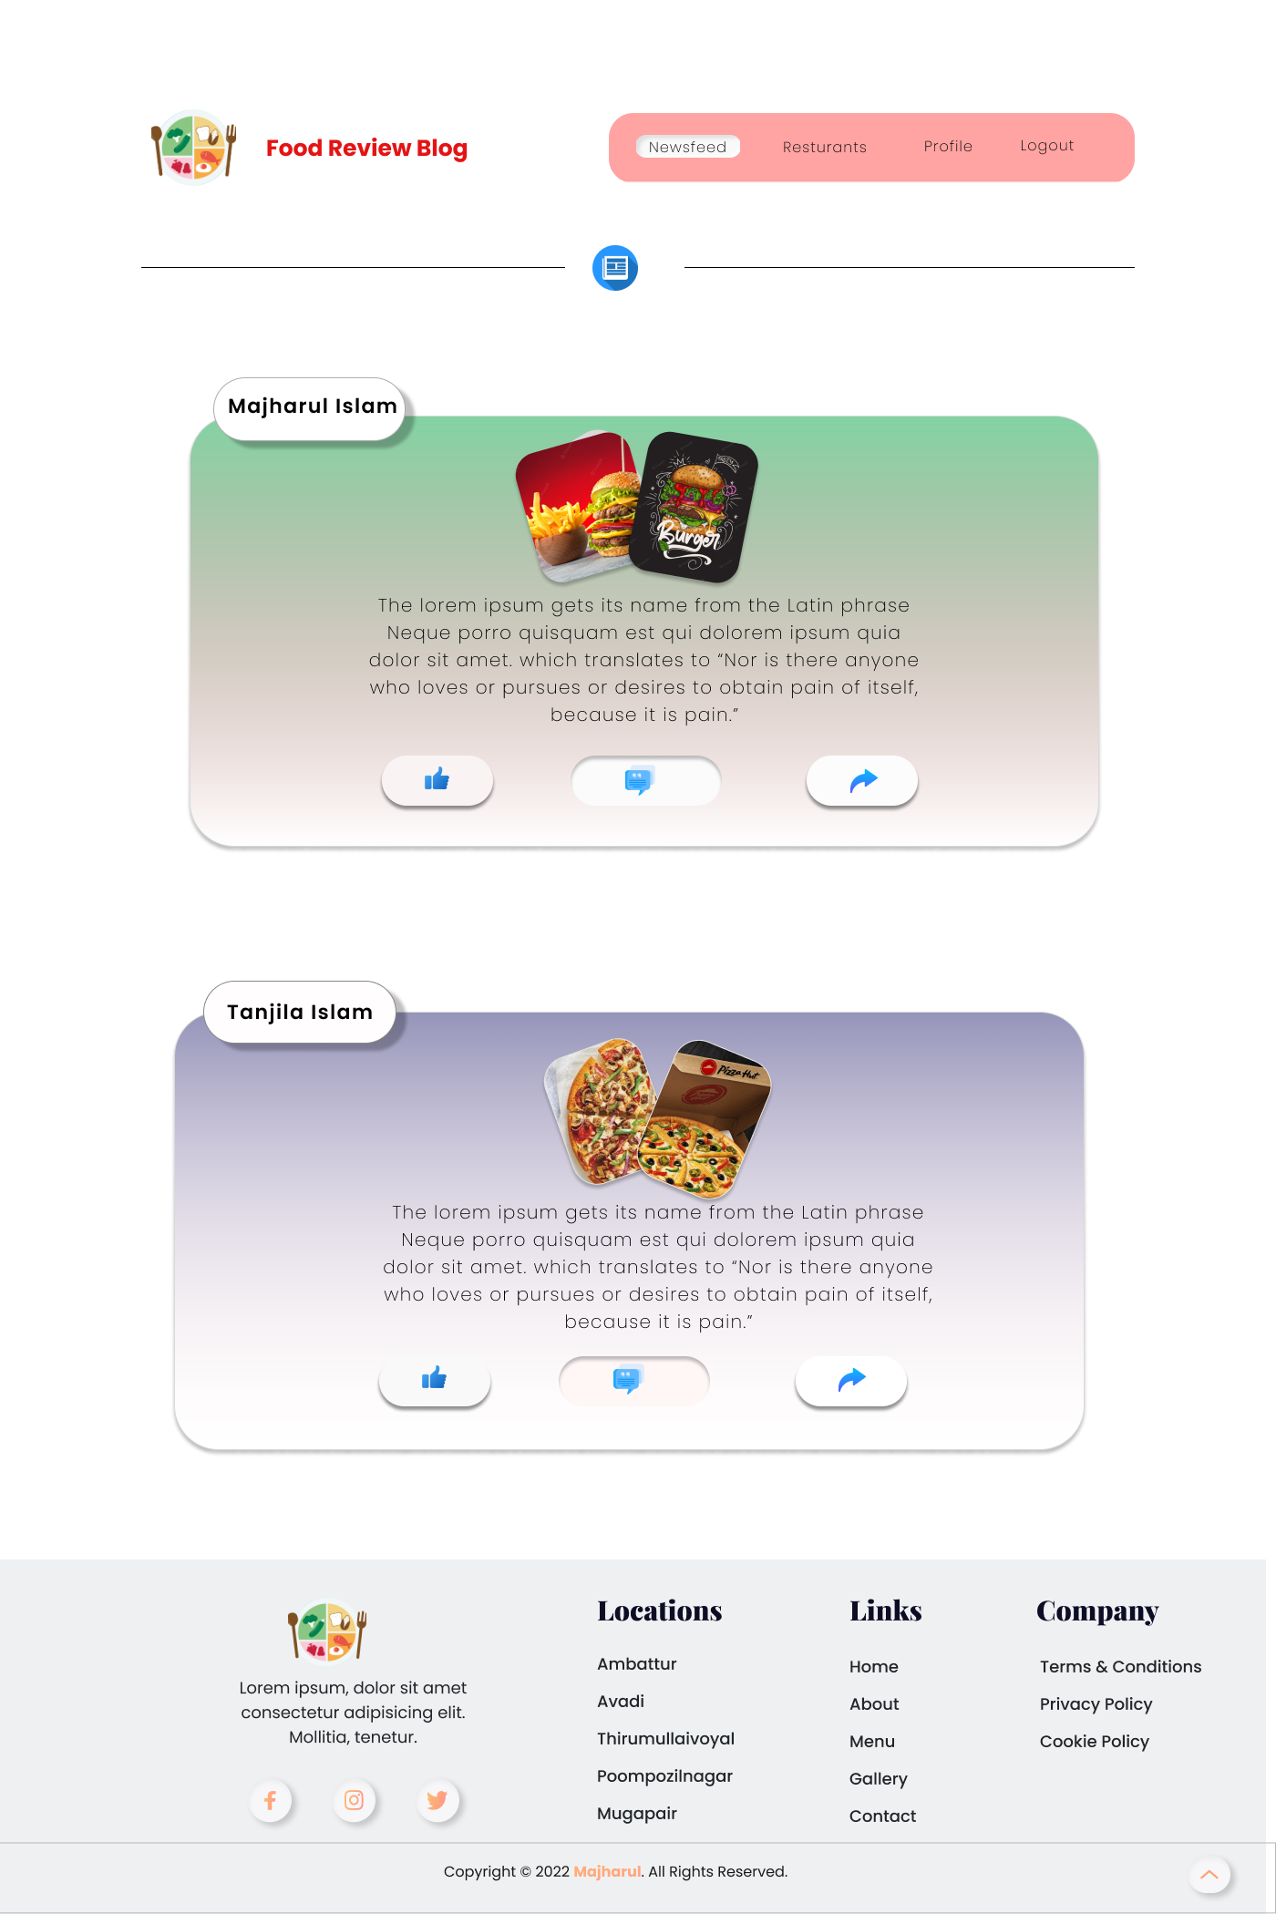
newsfeed
A registered User can see other’s Post, Reviews
Can React/Comment in other’s Post

Slide 8
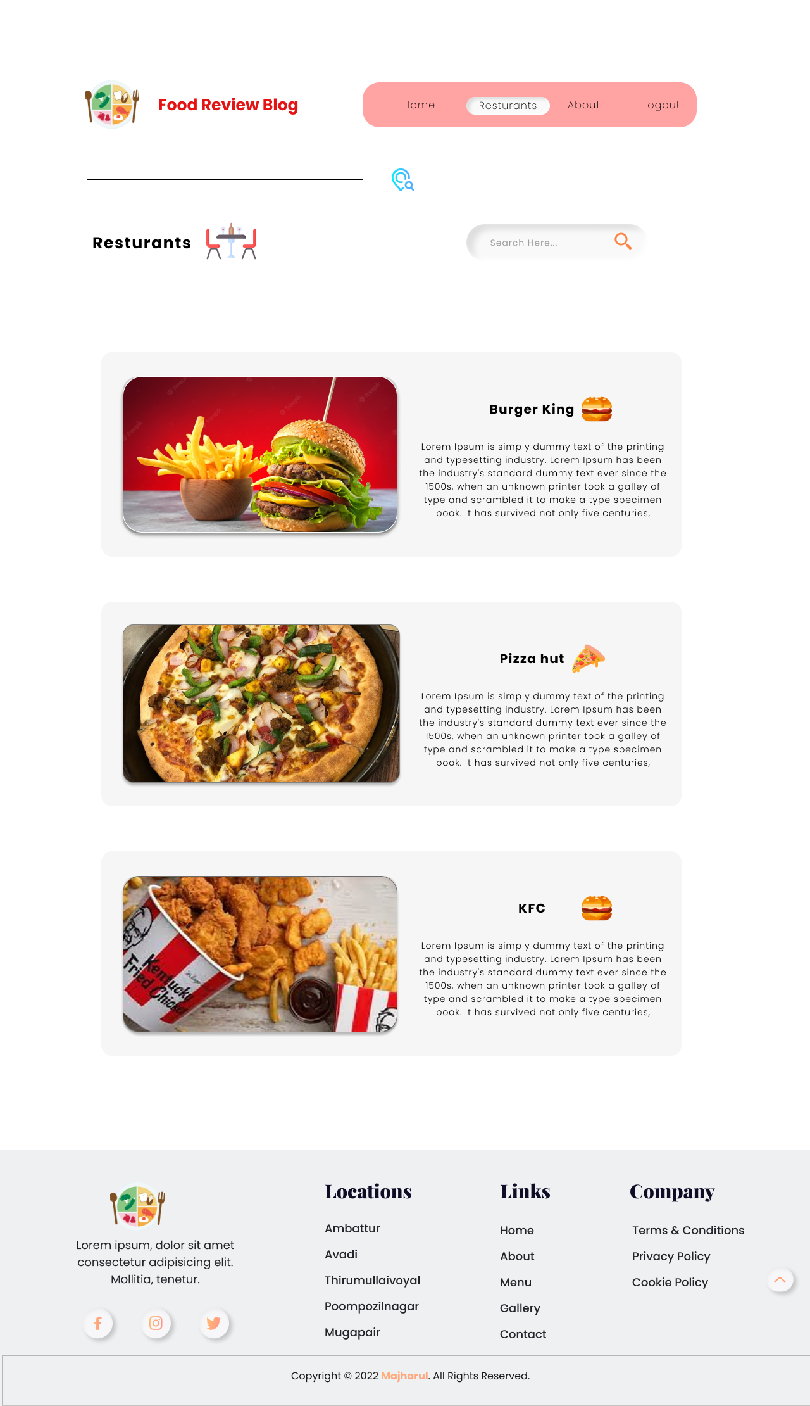
restaurants
A Restaurant Owner can share about his restaurant, Location, Rating & Special Notice by Creating A profile.
Can Search by Any Review / Reviewer

Slide 9
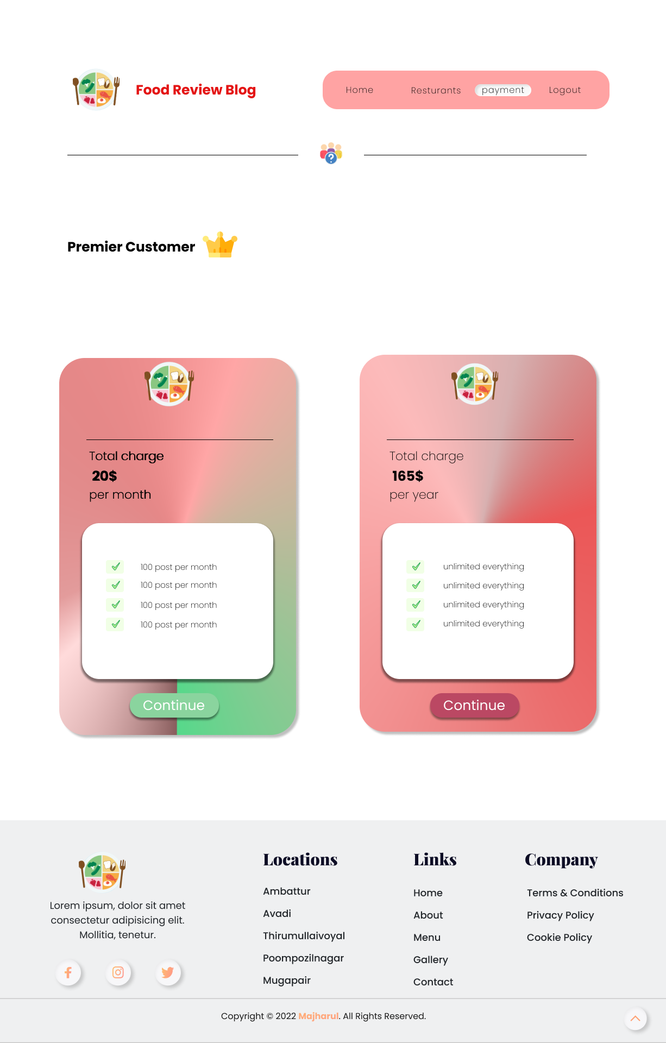
Premier customer
Act as a Special Feature
Premium Account by doing online payment

Slide 10
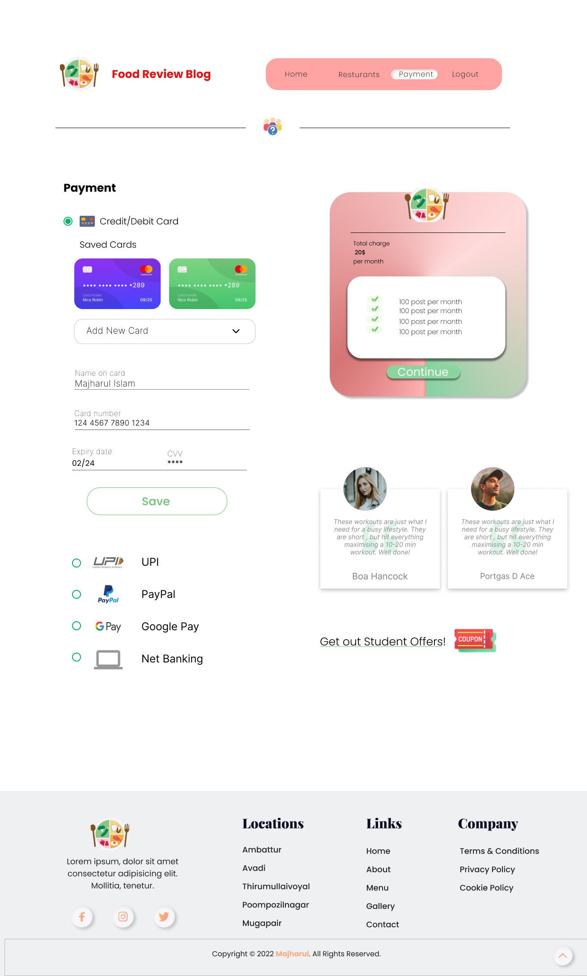
Payment Gateway For Premium User

Slide 11
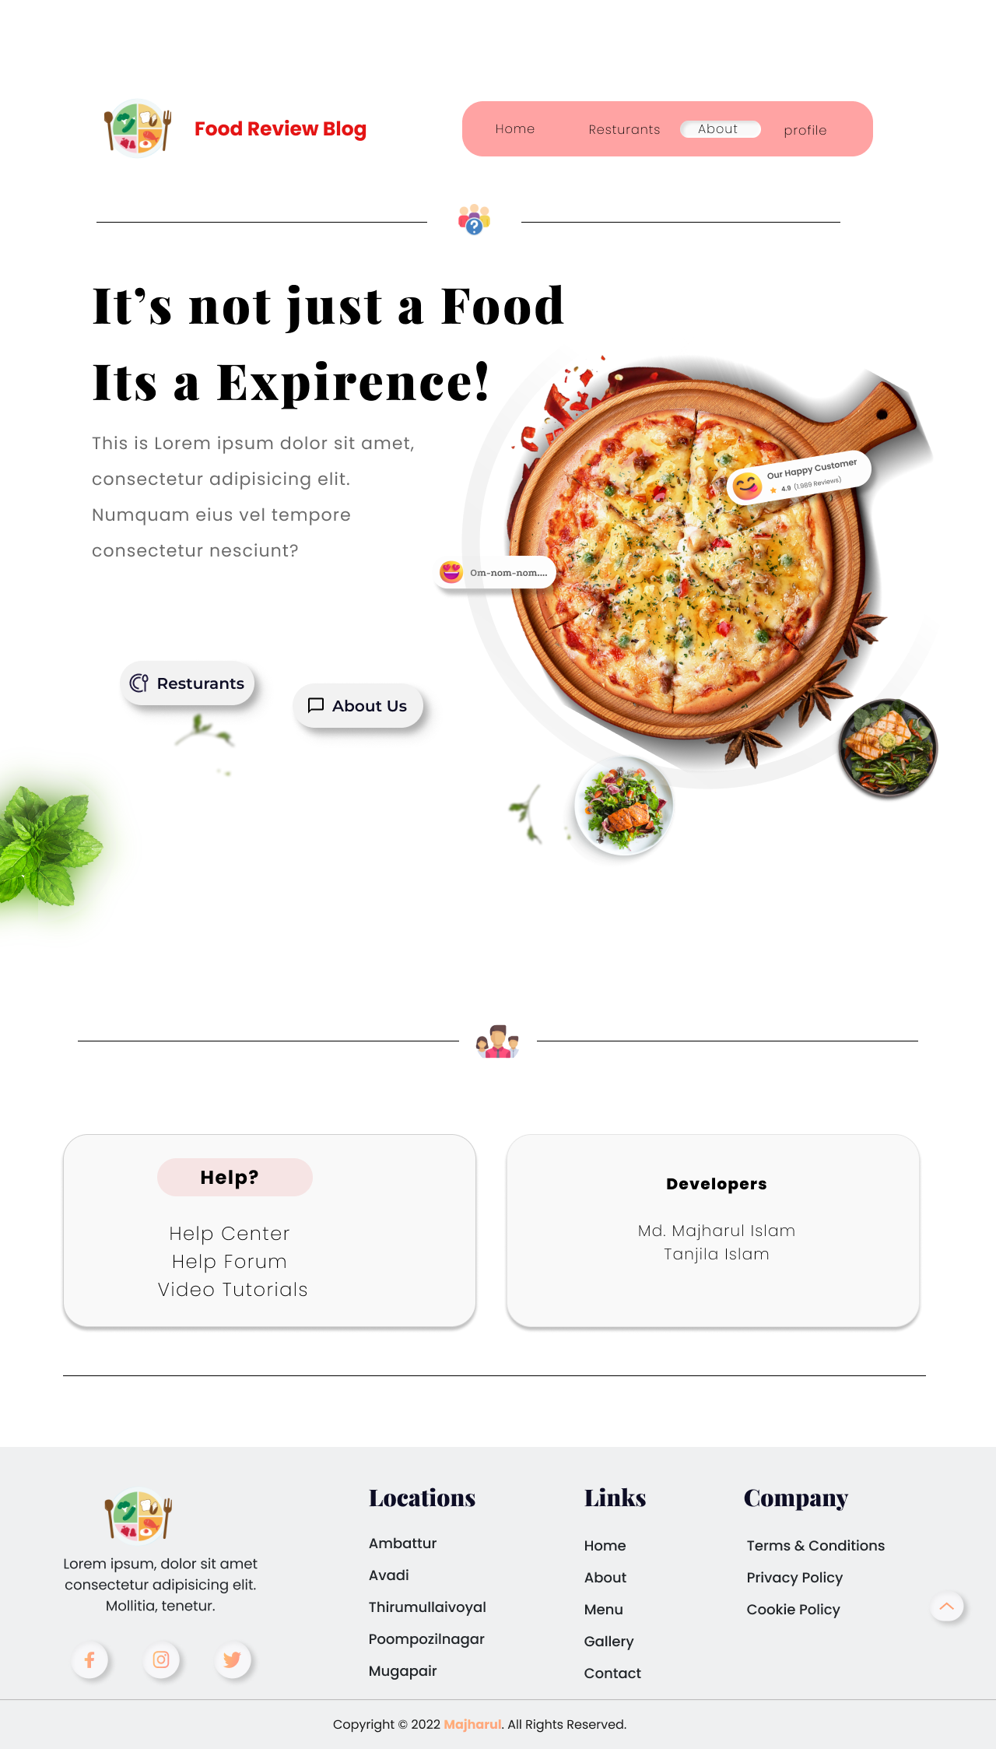
about
The Page will contain information of the Website
Find Support or any help

Slide 12

Thank You

